Slide 1
Chapter 3
Memory Management
Tanenbaum, Modern Operating Systems 3 e, (c) 2008 Prentice-Hall, Inc. All rights reserved. 0-13-6006639

Slide 2
Memory Management Basics
Don’t have infinite RAM
Do have a memory hierarchy-
  Cache (fast)
  Main(medium)
  Disk(slow)
Memory manager has the job of using this hierarchy to create an abstraction (illusion) of easily accessible memory
Tanenbaum, Modern Operating Systems 3 e, (c) 2008 Prentice-Hall, Inc. All rights reserved. 0-13-6006639

Slide 3

One program at a time in memory
OS reads program in from disk and it is executed
Tanenbaum, Modern Operating Systems 3 e, (c) 2008 Prentice-Hall, Inc. All rights reserved. 0-13-6006639

Slide 4
One program at a time
Can only have one program in memory at a time.
Bug in user program can trash the OS (a and c)
Second on some embedded systems
Third on MS-DOS (early PCs) -part in ROM called BIOS
Tanenbaum, Modern Operating Systems 3 e, (c) 2008 Prentice-Hall, Inc. All rights reserved. 0-13-6006639

Slide 5
Really want to run more than one program
Could swap new program into memory from disk and send old one out to disk
Not really concurrent
Tanenbaum, Modern Operating Systems 3 e, (c) 2008 Prentice-Hall, Inc. All rights reserved. 0-13-6006639

Slide 6
IBM static relocation idea
IBM 360 -divide memory into 2 KB blocks, and associate a 4 bit protection key with chunk. Keep keys in registers.
Put key into PSW (Program Status Word) for program
Hardware prevents program from accessing block with another protection key
Tanenbaum, Modern Operating Systems 3 e, (c) 2008 Prentice-Hall, Inc. All rights reserved. 0-13-6006639

Slide 7
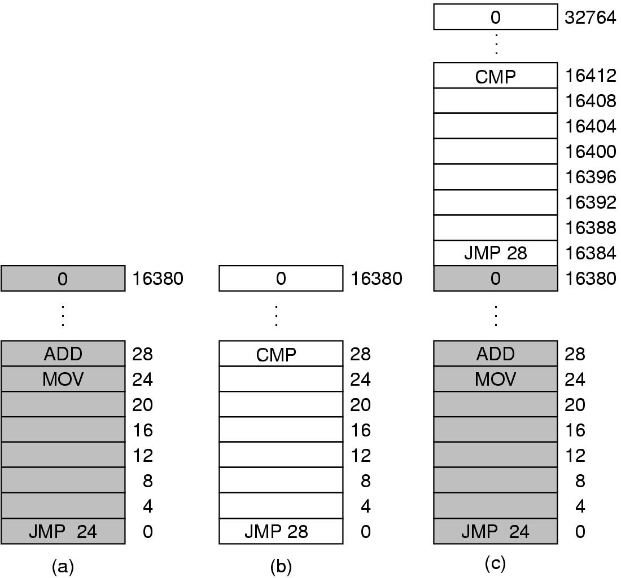
Problem with relocation
JMP 28 in program (b) trashes ADD instruction in location 28
Program crashes
Tanenbaum, Modern Operating Systems 3 e, (c) 2008 Prentice-Hall, Inc. All rights reserved. 0-13-6006639

Slide 8
Static relocation
Problem is that both programs reference absolute physical memory.
Static relocation- load first instruction of program at address x, and add x to every subsequent address during loading
  This is too slow and
  Not all addresses can be modified
    Mov register 1,28 can’t be modified
Tanenbaum, Modern Operating Systems 3 e, (c) 2008 Prentice-Hall, Inc. All rights reserved. 0-13-6006639

Slide 9
Address Space
Create abstract memory space for program to exist in
  Each program has its own set of addresses
  The addresses are different for each program
  Call it the address space of the program
Tanenbaum, Modern Operating Systems 3 e, (c) 2008 Prentice-Hall, Inc. All rights reserved. 0-13-6006639

Slide 10
Base and Limit Registers
A form of dynamic relocation
Base contains beginning address of program
Limit contains length of program
Program references memory, adds base address to address generated by process. Checks to see if address is larger then limit. If so, generates fault
Disadvantage-addition and comparison have to be done on every instruction
Used in the CDC 6600 and the Intel 8088
Tanenbaum, Modern Operating Systems 3 e, (c) 2008 Prentice-Hall, Inc. All rights reserved. 0-13-6006639

Slide 11
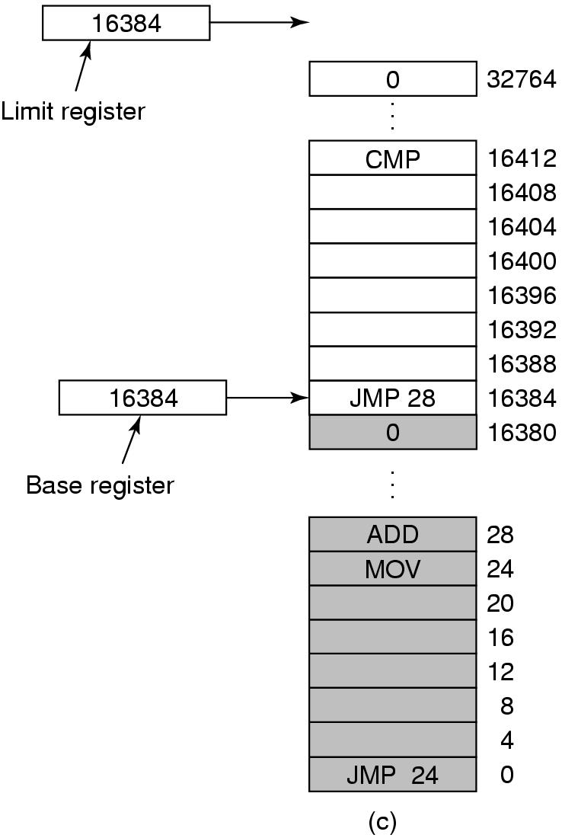
Base and Limit Registers
Add 16384 to JMP 28. Hardware adds 16384 to 28 resulting in JMP 16412
Tanenbaum, Modern Operating Systems 3 e, (c) 2008 Prentice-Hall, Inc. All rights reserved. 0-13-6006639

Slide 12
How to run more programs then fit in main memory at once
Can’t keep all processes in main memory
  Too many (hundreds)
  Too big (e.g. 200 MB program)
Two approaches
  Swap-bring program in and run it for awhile
  Virtual memory-allow program to run even if only part of it is in main memory
Tanenbaum, Modern Operating Systems 3 e, (c) 2008 Prentice-Hall, Inc. All rights reserved. 0-13-6006639

Slide 13

Swapping, a picture
Can compact holes by copying programs into holes
This takes too much time
Tanenbaum, Modern Operating Systems 3 e, (c) 2008 Prentice-Hall, Inc. All rights reserved. 0-13-6006639

Slide 14
Programs grow as they execute
Stack (return addresses and local variables)
Data segment (heap for variables which are dynamically allocated and released)
Good idea to allocate extra memory for both
When program goes back to disk, don’t bring holes along with it!!!
Tanenbaum, Modern Operating Systems 3 e, (c) 2008 Prentice-Hall, Inc. All rights reserved. 0-13-6006639

Slide 15

2 ways to allocate space for growth
Just add extra space
Stack grows downwards, data grows upwards
Tanenbaum, Modern Operating Systems 3 e, (c) 2008 Prentice-Hall, Inc. All rights reserved. 0-13-6006639

Slide 16
Managing Free Memory
Two techniques to keep track of free memory
  Bitmaps
  Linked lists
Tanenbaum, Modern Operating Systems 3 e, (c) 2008 Prentice-Hall, Inc. All rights reserved. 0-13-6006639

Slide 17

Bitmaps-the picture
(a)Picture of memory
(b)Each bit in bitmap corresponds to a unit of storage (e.g. bytes) in memory
(c) Linked list P: process H: hole
Tanenbaum, Modern Operating Systems 3 e, (c) 2008 Prentice-Hall, Inc. All rights reserved. 0-13-6006639

Slide 18
Bitmaps
The good-compact way to keep tract of memory
The bad-need to search memory for k consecutive zeros to bring in a file k units long
  Units can be bits or bytes or…….
Tanenbaum, Modern Operating Systems 3 e, (c) 2008 Prentice-Hall, Inc. All rights reserved. 0-13-6006639

Slide 19
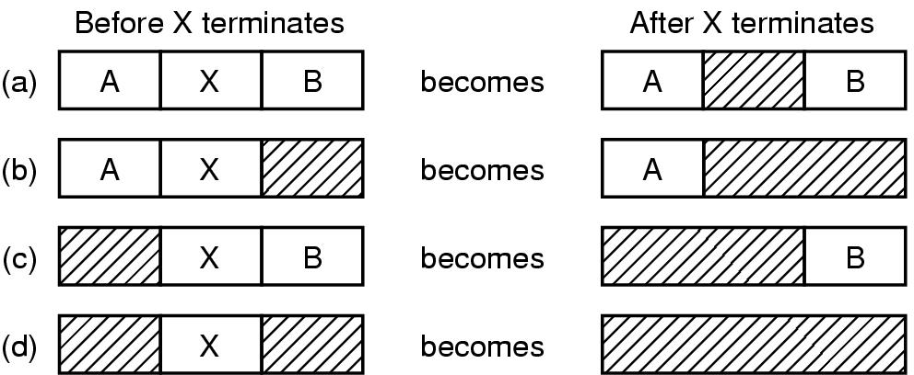
Linked Lists-the picture
Four neighbor combinations for the terminating process, X.
Tanenbaum, Modern Operating Systems 3 e, (c) 2008 Prentice-Hall, Inc. All rights reserved. 0-13-6006639

Slide 20
Linked Lists
Might want to use doubly linked lists to merge holes more easily
Algorithms to fill in the holes in memory
  Next fit
  Best fit
  Worst fit
  Quick fit
Tanenbaum, Modern Operating Systems 3 e, (c) 2008 Prentice-Hall, Inc. All rights reserved. 0-13-6006639

Slide 21
The fits
First fit-fast
Next fit-starts search wherever it is
  Slightly worse
Best fit-smallest hole that fits
  Slower, results in a bunch of small holes (i.e. worse algorithm)
Worst fit-largest hole that fits
  Not good (simulation results)
Quick fit- keep list of common sizes
  Quick, but can’t find neighbors to merge with
Tanenbaum, Modern Operating Systems 3 e, (c) 2008 Prentice-Hall, Inc. All rights reserved. 0-13-6006639

Slide 22
The fits
Conclusion: the fits couldn’t out-smart the
un-knowable distribution of hole sizes
Tanenbaum, Modern Operating Systems 3 e, (c) 2008 Prentice-Hall, Inc. All rights reserved. 0-13-6006639

Slide 23
Virtual Memory-the history
Keep multiple parts of programs in memory
Swapping is too slow (100 Mbytes/sec disk transfer rate=>10 sec to swap out a 1 Gbyte program)
Overlays-programmer breaks program into pieces which are swapped in by overlay manager
  Ancient idea-not really done
  Too hard to do-programmer has to break up program
Tanenbaum, Modern Operating Systems 3 e, (c) 2008 Prentice-Hall, Inc. All rights reserved. 0-13-6006639

Slide 24
Virtual Memory
Program’s address space is broken up into fixed size pages
Pages are mapped to physical memory
If instruction refers to a page in memory, fine
Otherwise OS gets the page, reads it in, and re-starts the instruction
While page is being read in, another process gets the CPU
Tanenbaum, Modern Operating Systems 3 e, (c) 2008 Prentice-Hall, Inc. All rights reserved. 0-13-6006639

Slide 25
Memory Management Unit
Memory Management Unit generates physical address from virtual address provided by the program
Tanenbaum, Modern Operating Systems 3 e, (c) 2008 Prentice-Hall, Inc. All rights reserved. 0-13-6006639

Slide 26

Memory Management Unit
MMU maps virtual addresses to physical addresses and puts them on memory bus
Tanenbaum, Modern Operating Systems 3 e, (c) 2008 Prentice-Hall, Inc. All rights reserved. 0-13-6006639

Slide 27
Pages and Page Frames
Virtual addresses divided into pages
  512 bytes-64 KB range
  Transfer between RAM and disk is in whole pages
  Example on next slide
Tanenbaum, Modern Operating Systems 3 e, (c) 2008 Prentice-Hall, Inc. All rights reserved. 0-13-6006639

Slide 28
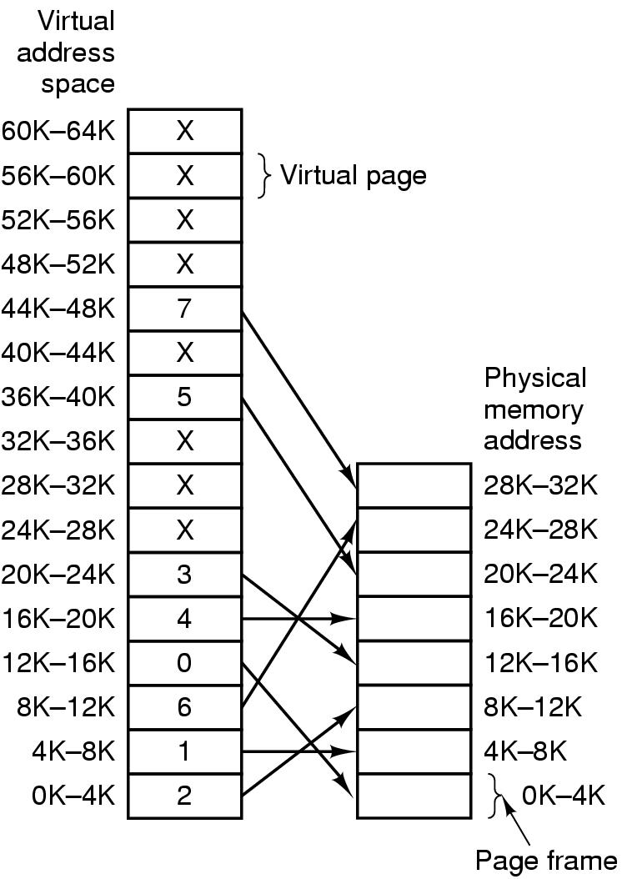
Mapping of pages to page frames
16 bit addresses, 4 KB pages
32 KB physical memory,
16 virtual pages and 8 page frames
Tanenbaum, Modern Operating Systems 3 e, (c) 2008 Prentice-Hall, Inc. All rights reserved. 0-13-6006639

Slide 29
Page Fault Processing
Present/absent bit tells whether page is in memory
What happens If address is not in memory?
Trap to the OS
  OS picks page to write to disk
  Brings page with (needed) address into memory
  Re-starts instruction
Tanenbaum, Modern Operating Systems 3 e, (c) 2008 Prentice-Hall, Inc. All rights reserved. 0-13-6006639

Slide 30

MMU operation
Tanenbaum, Modern Operating Systems 3 e, (c) 2008 Prentice-Hall, Inc. All rights reserved. 0-13-6006639

Slide 31
Page Table
Virtual address={virtual page number, offset}
Virtual page number used to index into page table to find page frame number
If present/absent bit is set to 1, attach page frame number to the front of the offset, creating the physical address
which is sent on the memory bus
Tanenbaum, Modern Operating Systems 3 e, (c) 2008 Prentice-Hall, Inc. All rights reserved. 0-13-6006639

Slide 32

Structure of Page Table Entry
Modified (dirty) bit: 1 means written to => have to write it to disk. 0 means don’t have to write to disk.
Referenced bit: 1 means it was either read or written. Used to pick page to evict. Don’t want to get rid of page which is being used.
Present (1) / Absent (0) bit
Protection bits: r, w, r/w
.
Tanenbaum, Modern Operating Systems 3 e, (c) 2008 Prentice-Hall, Inc. All rights reserved. 0-13-6006639

Slide 33
Problems for paging
Virtual to physical mapping is done on every memory reference => mapping must be fast
If the virtual address space is large, the page table will be large. 32 bit addresses now and 64 bits becoming more common
Tanenbaum, Modern Operating Systems 3 e, (c) 2008 Prentice-Hall, Inc. All rights reserved. 0-13-6006639

Slide 34
Stupid solutions
  Bring page table for a process into MMU when it is started up and store it in registers
  Keep page table in main memory
Tanenbaum, Modern Operating Systems 3 e, (c) 2008 Prentice-Hall, Inc. All rights reserved. 0-13-6006639

Slide 35
Speed up Address Translation
Most programs access a small number of pages a great deal
Add Translation Lookaside Buffer (TLB) to MMU
  Stores frequently accessed frames
Tanenbaum, Modern Operating Systems 3 e, (c) 2008 Prentice-Hall, Inc. All rights reserved. 0-13-6006639

Slide 36
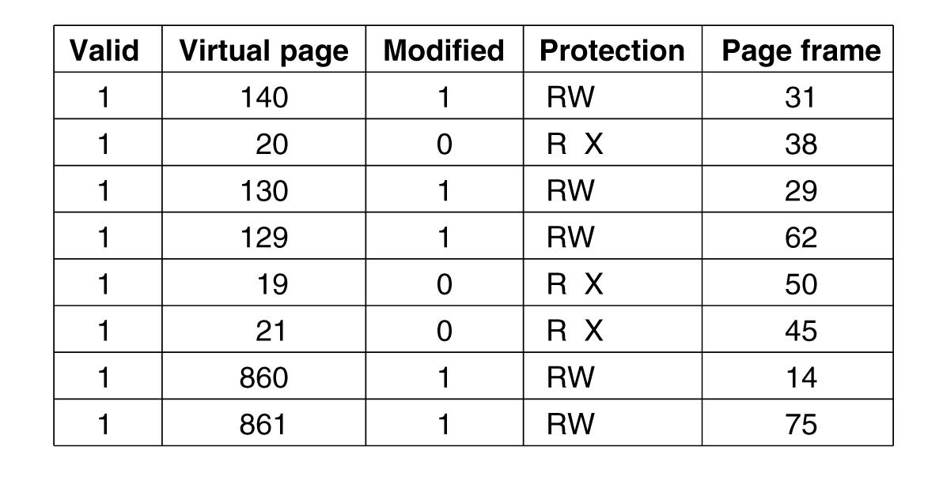
Translation Lookaside Buffers
Valid bit indicates whether page is in use or not
Tanenbaum, Modern Operating Systems 3 e, (c) 2008 Prentice-Hall, Inc. All rights reserved. 0-13-6006639

Slide 37
Translation Lookaside Buffer(TLB)
If address is in MMU, avoid page table
Uses parallel search to see if virtual page is in the TLB
If not, does page table look up and evicts TLB entry, replacing it with page just looked up
Tanenbaum, Modern Operating Systems 3 e, (c) 2008 Prentice-Hall, Inc. All rights reserved. 0-13-6006639

Slide 38
Software TLB management
RISC machines manage TLB in software
TLB fault processed by OS instead of by MMU hardware
Results less hardware in MMU and OK performance
Software can figure out which pages to pre-load into TLB (eg. Load server after client request)
Keeps cache of frequently used pages
Tanenbaum, Modern Operating Systems 3 e, (c) 2008 Prentice-Hall, Inc. All rights reserved. 0-13-6006639

Slide 39
Multi-level page tables
Want to avoid keeping the entire page table in memory because it is too big
Hierarchy of page tables does this
The hierarchy is a page table of page tables
Tanenbaum, Modern Operating Systems 3 e, (c) 2008 Prentice-Hall, Inc. All rights reserved. 0-13-6006639

Slide 40

Multilevel Page Tables
(a) A 32-bit address with two page table fields.
(b) Two-level page tables.
Tanenbaum, Modern Operating Systems 3 e, (c) 2008 Prentice-Hall, Inc. All rights reserved. 0-13-6006639

Slide 41
Use of multilevel page table
Top level of page table contains
  Entry 0 points to pages for program text
  Entry 1 points to pages for data
  Entry 1023 points to pages for stack
Tanenbaum, Modern Operating Systems 3 e, (c) 2008 Prentice-Hall, Inc. All rights reserved. 0-13-6006639

Slide 42
Multi-level page table gets too big
Multi-level page table works for 32 bit memory
Doesn’t work for 64 bit memory
2*64 bytes and 4 KB pages => 2*52 entries in page table
If each entry is 8 bytes=> 30 million Gbytes for page table
Need a new solution
Tanenbaum, Modern Operating Systems 3 e, (c) 2008 Prentice-Hall, Inc. All rights reserved. 0-13-6006639

Slide 43
Inverted Page Table
Keep one entry per (real) page frame in the “inverted” table
Entries keep track of (process,virtual page) associated with page frame
Need to find frame associated with (n,p) for each memory reference
Tanenbaum, Modern Operating Systems 3 e, (c) 2008 Prentice-Hall, Inc. All rights reserved. 0-13-6006639

Slide 44
Need to search inverted table efficiently
Search page frames on every memory reference
How to do this efficiently?
  Keep heavily used frames in TLB
  If miss, then can use and associative search to find virtual page to frame mapping
  Use a hash table
Tanenbaum, Modern Operating Systems 3 e, (c) 2008 Prentice-Hall, Inc. All rights reserved. 0-13-6006639

Slide 45
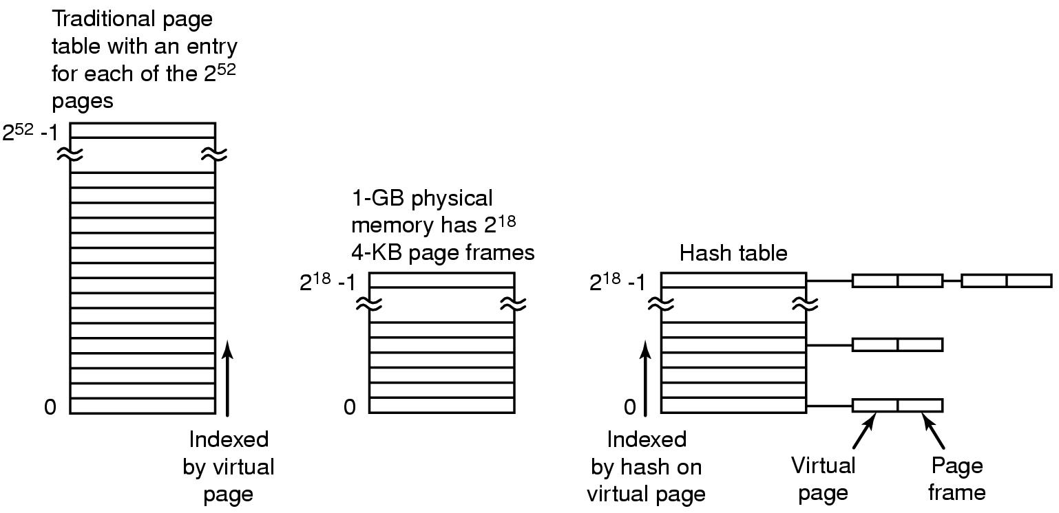
Inverted Page Tables-the picture
Tanenbaum, Modern Operating Systems 3 e, (c) 2008 Prentice-Hall, Inc. All rights reserved. 0-13-6006639

Slide 46
Page Replacement Algorithms
If new page is brought in, need to chose a page to evict
Don’t want to evict heavily used pages
If page has been written to, need to copy it to disk.
Otherwise, a good copy is on the disk=>can write over it
Tanenbaum, Modern Operating Systems 3 e, (c) 2008 Prentice-Hall, Inc. All rights reserved. 0-13-6006639

Slide 47
Page Replacement Algorithms-the Laundry List
Optimal page replacement algorithm
Not recently used page replacement
First-in, first-out page replacement
Second chance page replacement
Clock page replacement
Least recently used page replacement
Working set page replacement
WSClock page replacement
Tanenbaum, Modern Operating Systems 3 e, (c) 2008 Prentice-Hall, Inc. All rights reserved. 0-13-6006639

Slide 48
Optimal Page Replacement
Pick the one which will not used before the longest time
Not possible unless know when pages will be referenced (crystal ball)
Used as ideal reference algorithm
Tanenbaum, Modern Operating Systems 3 e, (c) 2008 Prentice-Hall, Inc. All rights reserved. 0-13-6006639

Slide 49
Not recently used
Use R and M bits
Periodically clear R bit
  Class 0: not referenced, not modified
  Class 1: not referenced, modified
  Class 2: referenced, not modified
  Class 3: referenced, modified
Pick lowest priority page to evict
Tanenbaum, Modern Operating Systems 3 e, (c) 2008 Prentice-Hall, Inc. All rights reserved. 0-13-6006639

Slide 50
FIFO
Keep list ordered by time (latest to arrive at the end of the list)
Evict the oldest, i.e. head of the line
Easy to implement
Oldest might be most heavily used! No knowledge of use is included in FIFO
Tanenbaum, Modern Operating Systems 3 e, (c) 2008 Prentice-Hall, Inc. All rights reserved. 0-13-6006639

Slide 51
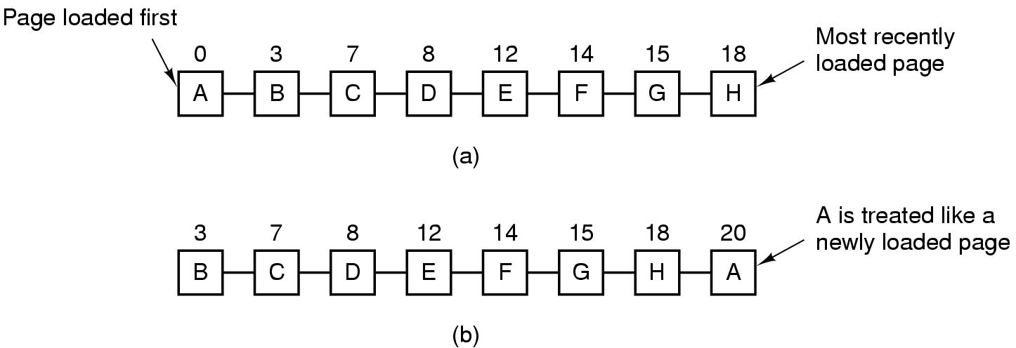
Second Chance Algorithm
Pages sorted in FIFO order by arrival time.
Examine R bit. If zero, evict. If one, put page at end of list and R is set to zero.
If change value of R bit frequently, might still evict a heavily used page
Tanenbaum, Modern Operating Systems 3 e, (c) 2008 Prentice-Hall, Inc. All rights reserved. 0-13-6006639

Slide 52
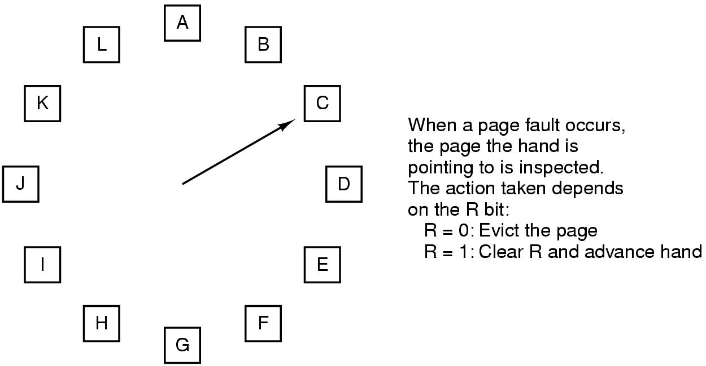
The Clock Page Replacement Algorithm
Tanenbaum, Modern Operating Systems 3 e, (c) 2008 Prentice-Hall, Inc. All rights reserved. 0-13-6006639

Slide 53
Clock
Doesn’t use age as a reason to evict page
Faster-doesn’t manipulate a list
Doesn’t distinguish between how long pages have not been referenced
Tanenbaum, Modern Operating Systems 3 e, (c) 2008 Prentice-Hall, Inc. All rights reserved. 0-13-6006639

Slide 54
LRU
Approximate LRU by assuming that recent page usage approximates long term page usage
Could associate counters with each page and examine them but this is expensive
Tanenbaum, Modern Operating Systems 3 e, (c) 2008 Prentice-Hall, Inc. All rights reserved. 0-13-6006639

Slide 55
LRU-the hardware array
Associate counter with each page.
  At each reference increment counter.
  Evict page with lowest counter
Keep n x n array for n pages.Upon reference page k, put 1’s in row k and 0’s in column k.
  Row with smallest binary value corresponds to LRU page. Evict k!
  Easy hardware implementation
Tanenbaum, Modern Operating Systems 3 e, (c) 2008 Prentice-Hall, Inc. All rights reserved. 0-13-6006639

Slide 56
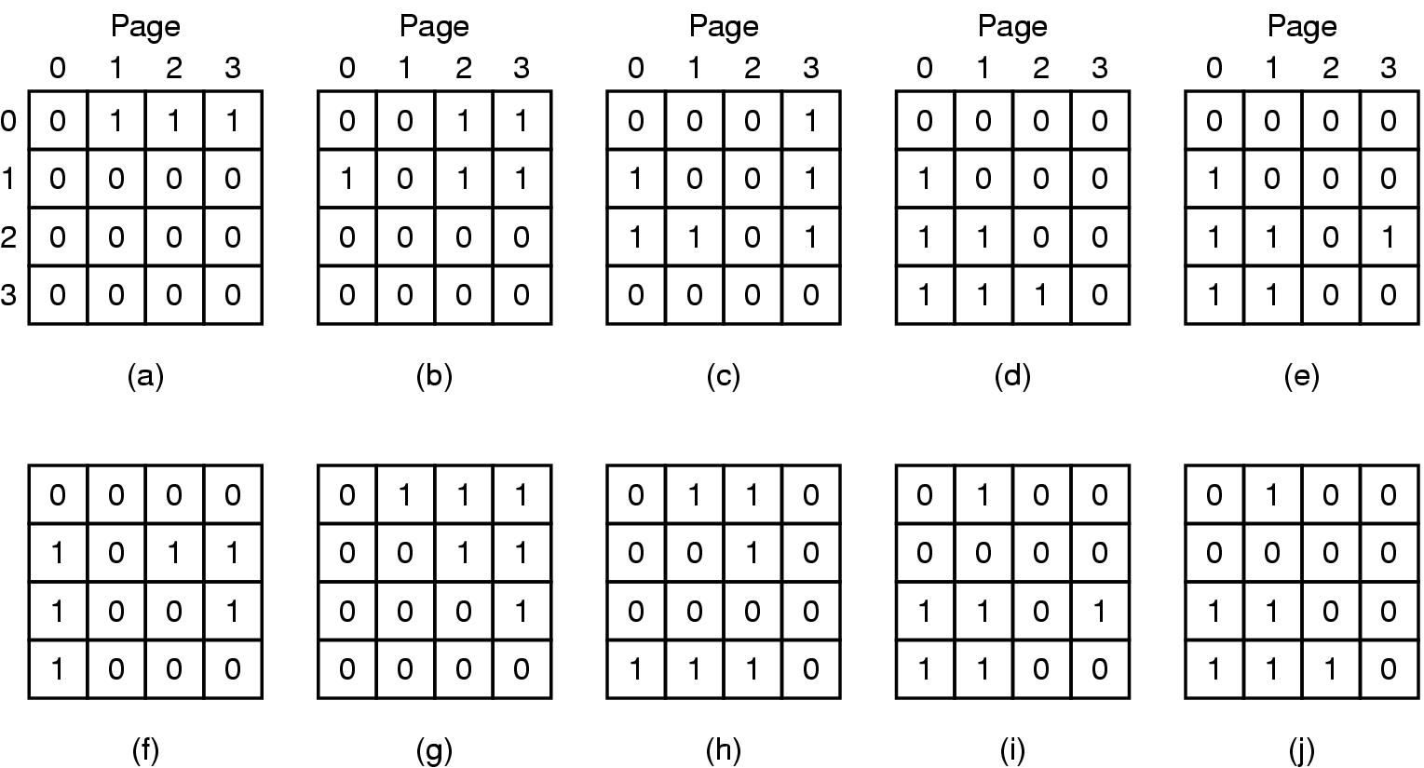
LRU-hardware
LRU using a matrix when pages are referenced in the order 0, 1, 2, 3, 2, 1, 0, 3, 2, 3.
Tanenbaum, Modern Operating Systems 3 e, (c) 2008 Prentice-Hall, Inc. All rights reserved. 0-13-6006639

Slide 57
LRU-software
Hardware uses space=> software implementation
Make use of software counters
Tanenbaum, Modern Operating Systems 3 e, (c) 2008 Prentice-Hall, Inc. All rights reserved. 0-13-6006639

Slide 58
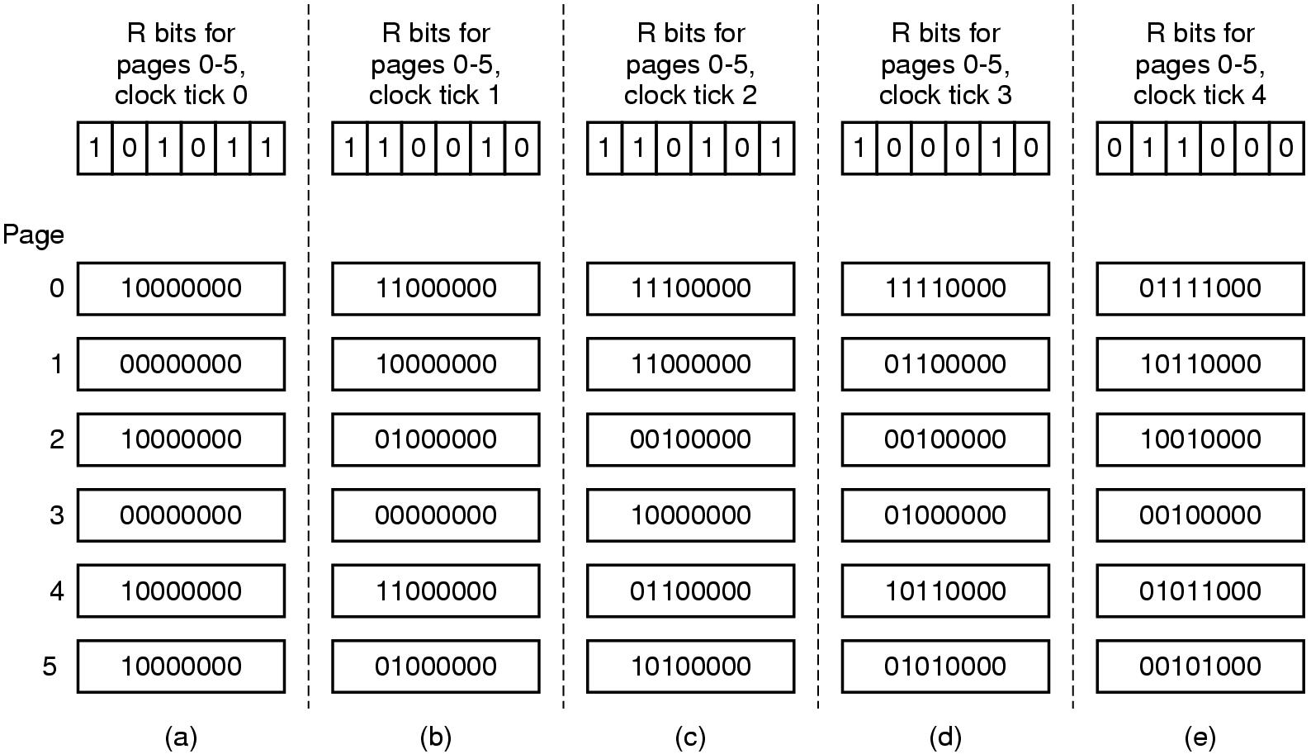
LRU in Software
Tanenbaum, Modern Operating Systems 3 e, (c) 2008 Prentice-Hall, Inc. All rights reserved. 0-13-6006639

Slide 59
LRU-software
  “aging” algorithm
  Keep a string of values of the R bits for each clock tick (up to some limit)
  After tick, shift bits right and add new R values on the left
  On page fault, evict page with lowest counter
  Size of the counter determines the history
Tanenbaum, Modern Operating Systems 3 e, (c) 2008 Prentice-Hall, Inc. All rights reserved. 0-13-6006639

Slide 60
Working Set Model
Demand paging-bring a process into memory by trying to execute first instruction and getting page fault. Continue until all pages that process needs to run are in memory (the working set)
Try to make sure that working set is in memory before letting process run (pre-paging)
Thrashing-memory is too small to contain working set, so page fault all of the time
Tanenbaum, Modern Operating Systems 3 e, (c) 2008 Prentice-Hall, Inc. All rights reserved. 0-13-6006639

Slide 61
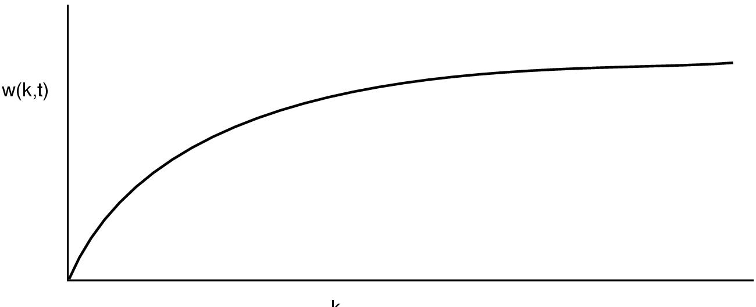
Behavior of working set as a function of k
W(k,t) is number of pages at time t used by k most recent memory references
Tanenbaum, Modern Operating Systems 3 e, (c) 2008 Prentice-Hall, Inc. All rights reserved. 0-13-6006639

Slide 62
How to implement working set model
When fault occurs can evict page not in working set (if there is such a page)
Need to pick k
Could keep track of pages in memory at every memory reference. Each k references results in a working set.
Shift register implementation. Insert page number at each reference.
Expensive
Tanenbaum, Modern Operating Systems 3 e, (c) 2008 Prentice-Hall, Inc. All rights reserved. 0-13-6006639

Slide 63
Use virtual time instead of number of references (k)
Keep track of k last pages referenced during a period t of execution (CPU) time
Virtual time for a process is the amount of CPU time used since it started
  Measure of how much work a process has done
Tanenbaum, Modern Operating Systems 3 e, (c) 2008 Prentice-Hall, Inc. All rights reserved. 0-13-6006639

Slide 64
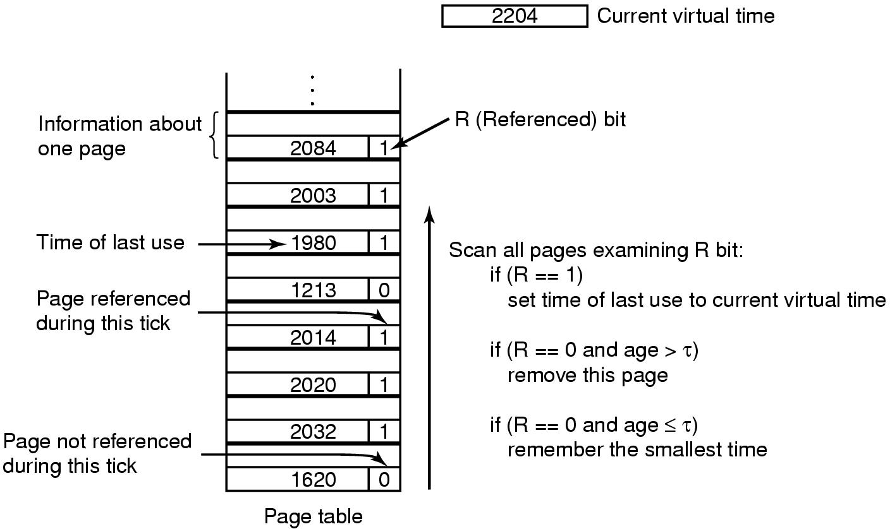
Working Set Page Replacement
(Check each clock tick)
Check each clock tick
Get rid of page with smallest time if all of the pages have R==0
Tanenbaum, Modern Operating Systems 3 e, (c) 2008 Prentice-Hall, Inc. All rights reserved. 0-13-6006639

Slide 65
Weakness with WS algorithm
Need to scan entire page table at each page fault to find a victim
Use clock idea with working set algorithm
Tanenbaum, Modern Operating Systems 3 e, (c) 2008 Prentice-Hall, Inc. All rights reserved. 0-13-6006639

Slide 66
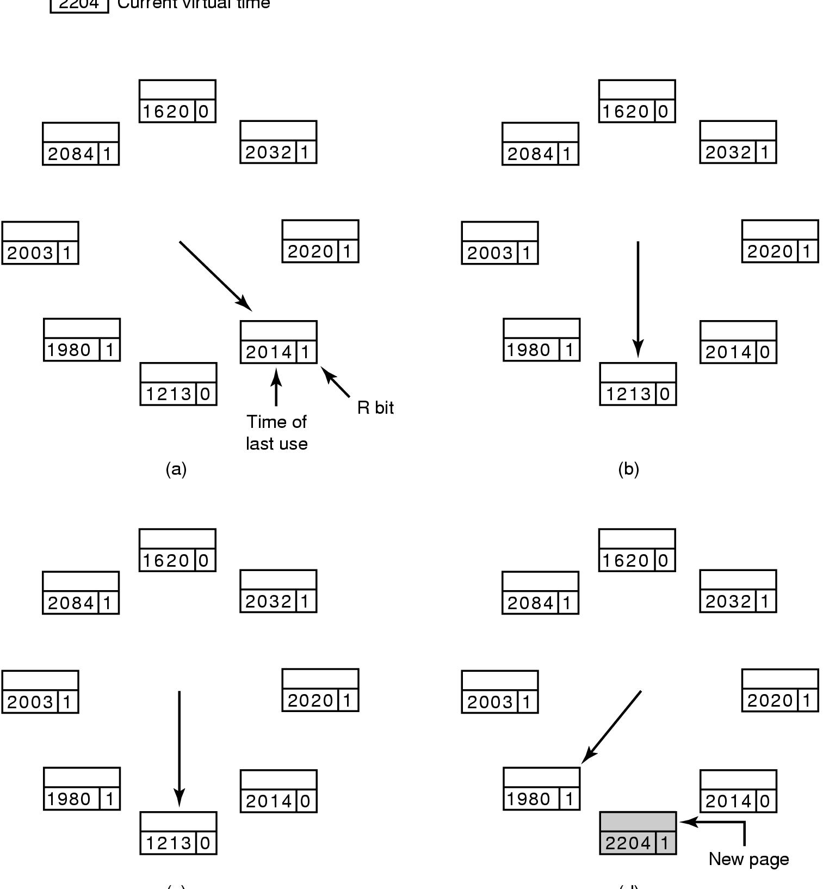
The WSClock Page Replacement Algorithm
Operation of the WSClock algorithm. (a) and (b) give an example of what happens when R = 1.
Tanenbaum, Modern Operating Systems 3 e, (c) 2008 Prentice-Hall, Inc. All rights reserved. 0-13-6006639

Slide 67
The WSClock Page Replacement Algorithm (3)
Operation of the WSClock algorithm.
(c) and (d) give an example of R = 0.
Tanenbaum, Modern Operating Systems 3 e, (c) 2008 Prentice-Hall, Inc. All rights reserved. 0-13-6006639

Slide 68
The WSClock Page Replacement Algorithm
If the hand comes all the way around to its
starting point there are two cases to consider:
At least one write has been scheduled.
  Hand keeps moving looking for clean page. Finds it because a write eventually completes- evicts first clean page hand comes to.
No writes have been scheduled.
  Evict first (clean) page
Tanenbaum, Modern Operating Systems 3 e, (c) 2008 Prentice-Hall, Inc. All rights reserved. 0-13-6006639

Slide 69
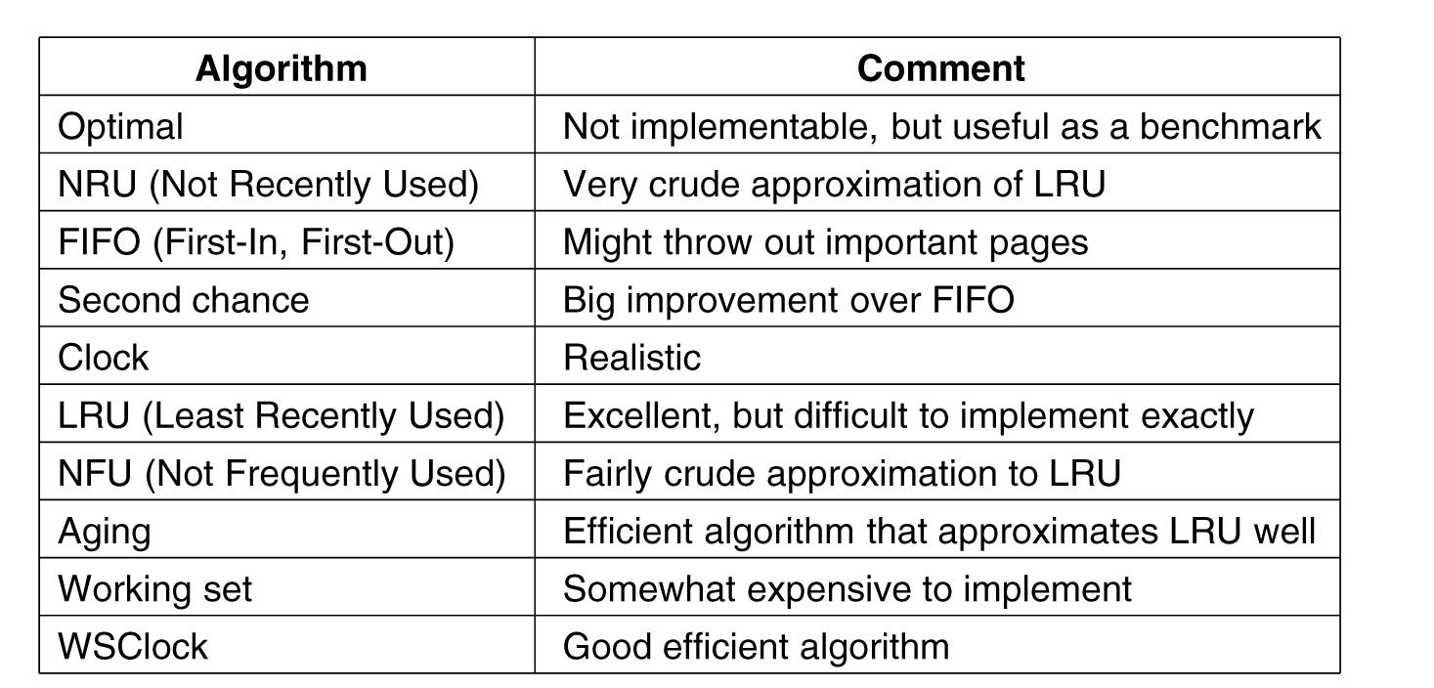
Summary of Page Replacement Algorithms
.
Tanenbaum, Modern Operating Systems 3 e, (c) 2008 Prentice-Hall, Inc. All rights reserved. 0-13-6006639

Slide 70
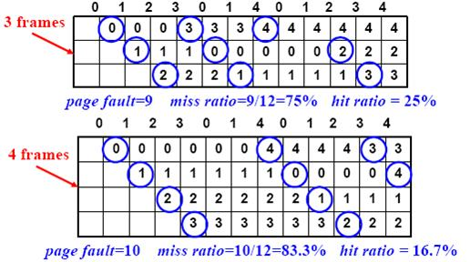
Bélády's anomaly
Which increasing the number of page frames results in an increase in the number of page faults for certain memory access patterns. This phenomenon is commonly experienced when using the first-in first-out (FIFO) page replacement algorithm.

Slide 71
Implementation Issues
Need to take into account a number of design issues in order to get a working algorithm
Tanenbaum, Modern Operating Systems 3 e, (c) 2008 Prentice-Hall, Inc. All rights reserved. 0-13-6006639

Slide 72
Global versus Local choice of page
Global-take into account all of the processes
Local-take into account just the process which faulted
Tanenbaum, Modern Operating Systems 3 e, (c) 2008 Prentice-Hall, Inc. All rights reserved. 0-13-6006639

Slide 73
Global is better for the memory
Working sets grow and shrink over time
Processes have different sizes
Assign number of pages to each process proportional to its size
Start with allocation based on size and use page fault frequency (pff) to modify allocation size for each process
Tanenbaum, Modern Operating Systems 3 e, (c) 2008 Prentice-Hall, Inc. All rights reserved. 0-13-6006639

Slide 74
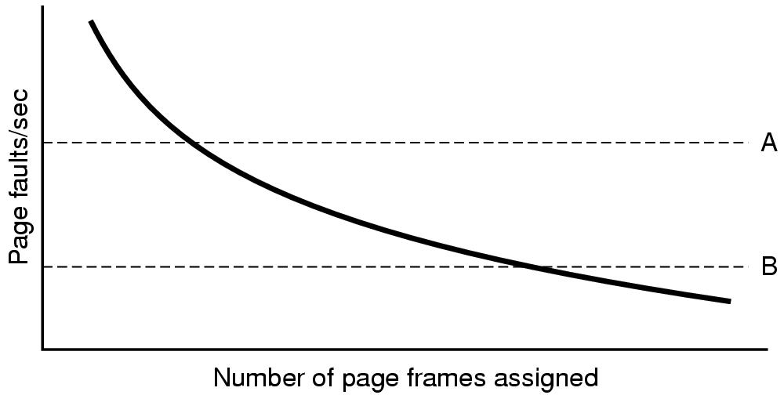
PFF used to determine page allocation
Maintain upper (A) and lower (B) bounds for pff Try to keep process in between bounds
Tanenbaum, Modern Operating Systems 3 e, (c) 2008 Prentice-Hall, Inc. All rights reserved. 0-13-6006639

Slide 75
Local Versus Global
Can use combination of algorithms
PFF is global component-determines page allocation
Replacement algorithm Is local component-determines which page to kick out
Tanenbaum, Modern Operating Systems 3 e, (c) 2008 Prentice-Hall, Inc. All rights reserved. 0-13-6006639

Slide 76
Load Control
Why? Can still thrash because of too much demand for memory.
Solution-swap process(es) out .
  Ie. When desperate, get rid of a process
Tanenbaum, Modern Operating Systems 3 e, (c) 2008 Prentice-Hall, Inc. All rights reserved. 0-13-6006639

Slide 77
Page size
Overhead= s*e/p + p/2 [size of page entries + frag]
  p is page size,
  s is process size,
  e is size of the page entry (in page table)
Differentiate, set to zero => p = √(2s*e)
  s= 1 MB, e=8 bytes 4 KB is optimal
  1 KB is typical
  4-8 KB common
  OK, this is a rough approach
Tanenbaum, Modern Operating Systems 3 e, (c) 2008 Prentice-Hall, Inc. All rights reserved. 0-13-6006639

Slide 78
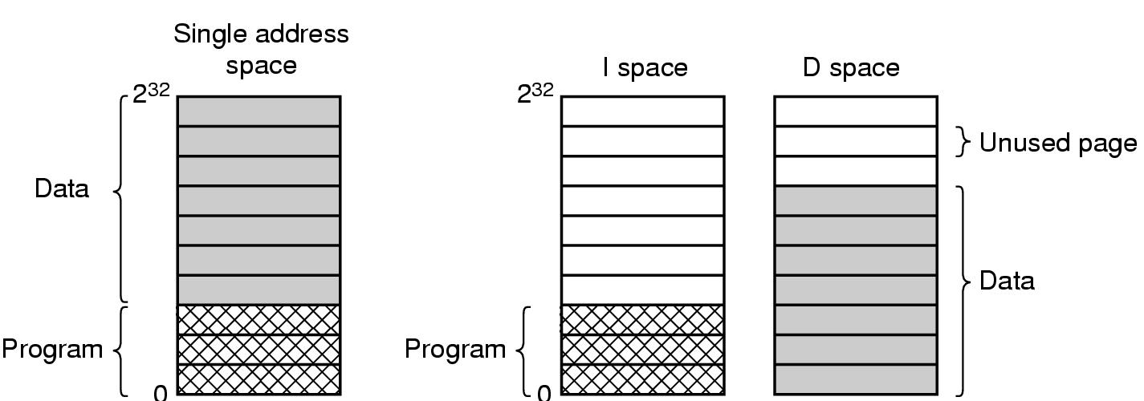
Separate Instruction and Data Address Spaces
Process address space too small => difficult to fit program in space
Split space into instructions (I) and data (D)
Old idea
Tanenbaum, Modern Operating Systems 3 e, (c) 2008 Prentice-Hall, Inc. All rights reserved. 0-13-6006639

Slide 79
Shared Pages
Different users can run same program (with different data) at the same time. Better to share pages then to have 2 copies!
Not all pages can be shared (data can’t be shared, text can be shared)
If have D,I spaces can have process entry in process table point to I and D pages
Tanenbaum, Modern Operating Systems 3 e, (c) 2008 Prentice-Hall, Inc. All rights reserved. 0-13-6006639

Slide 80
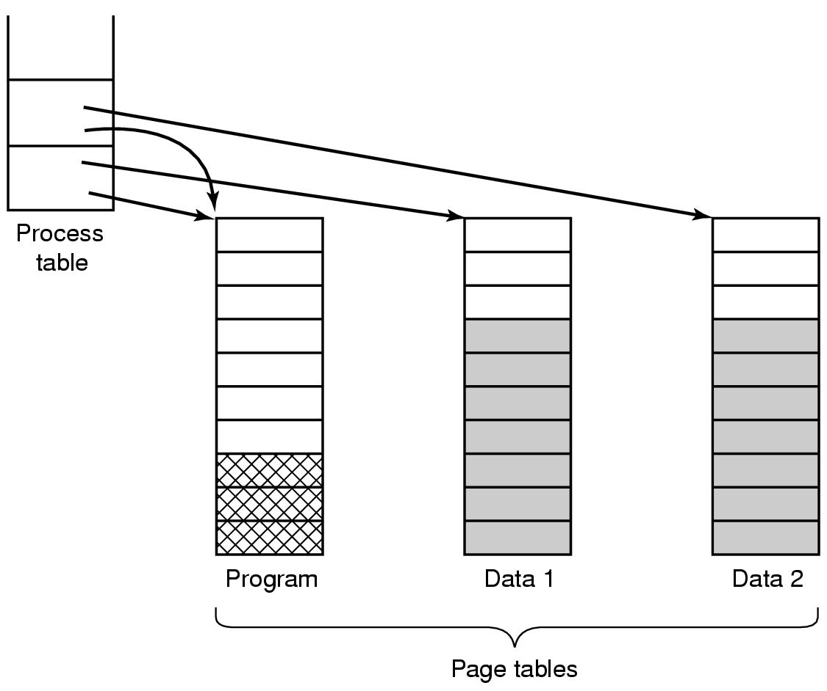
Shared Pages
Tanenbaum, Modern Operating Systems 3 e, (c) 2008 Prentice-Hall, Inc. All rights reserved. 0-13-6006639

Slide 81
More page sharing
Process can’t drop pages when it exits w/o being certain that they not still in use
  Use special data structure to track shared pages
Data sharing is painful (e.g. Unix fork, parent and child share text and data) because of page writes
  (Copy on write) solution is to map data to read only pages. If write occurs, each process gets its own page.
Tanenbaum, Modern Operating Systems 3 e, (c) 2008 Prentice-Hall, Inc. All rights reserved. 0-13-6006639

Slide 82
Shared Libraries
Large libraries (e.g. graphics) used by many process. Too expensive to bind to each process which wants to use them. Use shared libraries instead.
Unix linking: ld*.o –lc –lm . Files (and no others) not present in .o are located in m or c libraries and included in binaries.
Write object program to disk.
Tanenbaum, Modern Operating Systems 3 e, (c) 2008 Prentice-Hall, Inc. All rights reserved. 0-13-6006639

Slide 83
Shared Libraries
Linker uses a stub routine to call which binds to called function AT RUN TIME.
  Shared library is only loaded once (first time that a function in it is referenced).
  It is paged in
Need to use position independent code to avoid going to the wrong address (next slide).
  Idea: Compiler does not produce absolute addresses when using shared libraries; only relative addresses.
Tanenbaum, Modern Operating Systems 3 e, (c) 2008 Prentice-Hall, Inc. All rights reserved. 0-13-6006639

Slide 84
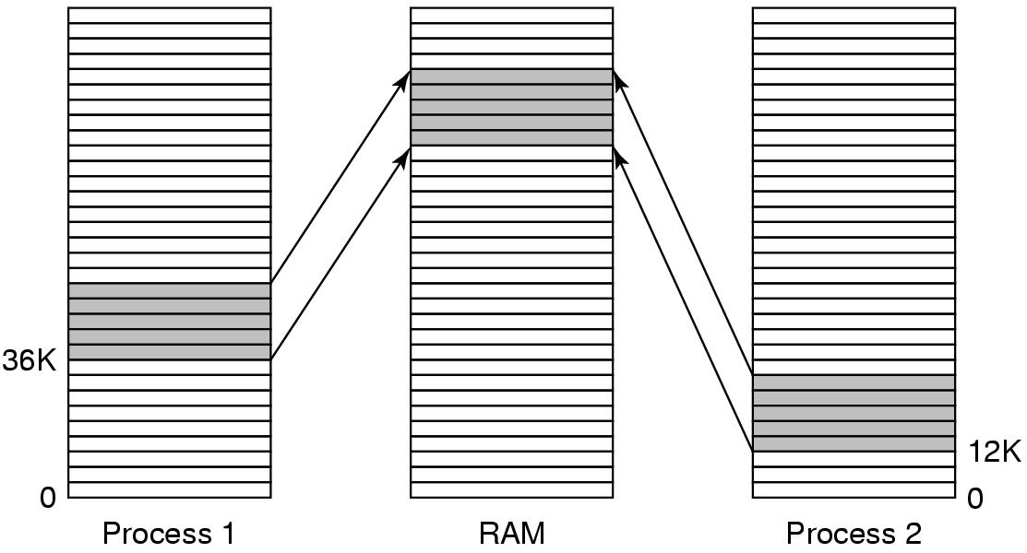
Shared Libraries
.
Tanenbaum, Modern Operating Systems 3 e, (c) 2008 Prentice-Hall, Inc. All rights reserved. 0-13-6006639

Slide 85
Memory Mapped Files
Process issues system call to map a file onto a part of its virtual address space.
Can be used to communicate via shared memory. Processes share same file. Use it to read and write.
Tanenbaum, Modern Operating Systems 3 e, (c) 2008 Prentice-Hall, Inc. All rights reserved. 0-13-6006639

Slide 86
Cleaning Policy
Use a daemon to locate pages to evict before you need them instead of looking for victims when you need them
Daemon sleeps most of the time, periodically awakens If there are “too few” frames, kicks out frames
Make sure that they are clean before claiming them
Tanenbaum, Modern Operating Systems 3 e, (c) 2008 Prentice-Hall, Inc. All rights reserved. 0-13-6006639

Slide 87
Virtual Memory Interface
Might want 2 programs to share physical memory
Easy way to implement shared message passing
  Avoids memory copies
Distributed shared memory-page fault handler locates page in different machine, which sends page to machine that needs it
Tanenbaum, Modern Operating Systems 3 e, (c) 2008 Prentice-Hall, Inc. All rights reserved. 0-13-6006639

Slide 88
Implementation
OS has lots of involvement in paging when process is: created,executes,page fault happens,terminates
Look at several specific issues/problems
  Page fault handling
  Instruction backup
  Locking pages in memory
  Backing store-where to put pages on disk
Tanenbaum, Modern Operating Systems 3 e, (c) 2008 Prentice-Hall, Inc. All rights reserved. 0-13-6006639

Slide 89
Page Fault Handling (1)
The hardware traps to the kernel, saving the program counter on the stack.
An assembly code routine is started to save the general registers and other volatile information.
The operating system discovers that a page fault has occurred, and tries to discover which virtual page is needed.
Once the virtual address that caused the fault is known, the system checks to see if this address is valid and the protection consistent with the access
Tanenbaum, Modern Operating Systems 3 e, (c) 2008 Prentice-Hall, Inc. All rights reserved. 0-13-6006639

Slide 90
Page Fault Handling (2)
If the page frame selected is dirty, the page is scheduled for transfer to the disk, and a context switch takes place.
When page frame is clean, operating system looks up the disk address where the needed page is, schedules a disk operation to bring it in.
When disk interrupt indicates page has arrived, page tables updated to reflect position, frame marked as being in normal state.
Tanenbaum, Modern Operating Systems 3 e, (c) 2008 Prentice-Hall, Inc. All rights reserved. 0-13-6006639

Slide 91
Page Fault Handling (3)
Faulting instruction backed up to state it had when it began and program counter reset to point to that instruction.
Faulting process scheduled, operating system returns to the (assembly language) routine that called it.
This routine reloads registers and other state information and returns to user space to continue execution, as if no fault had occurred.
Tanenbaum, Modern Operating Systems 3 e, (c) 2008 Prentice-Hall, Inc. All rights reserved. 0-13-6006639

Slide 92
Instruction Backup
Instruction causes fault => stopped part way through, traps to OS for fault handling, OS returns to instruction
Must re-start instruction
Easier said then done! For example
Tanenbaum, Modern Operating Systems 3 e, (c) 2008 Prentice-Hall, Inc. All rights reserved. 0-13-6006639

Slide 93
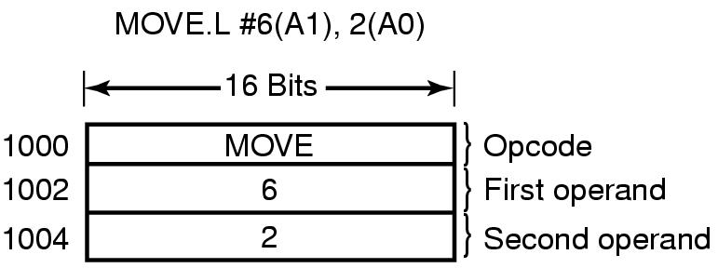
Instruction Backup (Motorola 680 x 2)
Where to re-start the instruction? PC depends on which part of the instruction actually faulted. If it faults at 1002, how does OS know that instruction starts at 1000?.
Tanenbaum, Modern Operating Systems 3 e, (c) 2008 Prentice-Hall, Inc. All rights reserved. 0-13-6006639

Slide 94
Instruction Backup
Worse yet: Auto-incrementing loads registers either before or after instruction is executed. Do it before and needs to be un-done. Do it afterwards and must not do it.
Hardware solution to instruction backup-copy current instruction to a register just before the instruction is executed
Otherwise OS is deep in the swamp
Tanenbaum, Modern Operating Systems 3 e, (c) 2008 Prentice-Hall, Inc. All rights reserved. 0-13-6006639

Slide 95
Locking Pages in Memory
Process does I/O call, waits for data
Gets suspended while waiting, new process read in, new process page faults
Global paging algorithm => incoming data writes over new page
Solution: Lock pages engaged in I/O
Tanenbaum, Modern Operating Systems 3 e, (c) 2008 Prentice-Hall, Inc. All rights reserved. 0-13-6006639

Slide 96
Backing Store
Where is page put on disk when it is swapped out? Two approaches
  Separate disk
  Use separate partition on disk which has no file system on it
Tanenbaum, Modern Operating Systems 3 e, (c) 2008 Prentice-Hall, Inc. All rights reserved. 0-13-6006639

Slide 97
Backing Store
Static Partition-Allocate fixed partition to process when it starts up
  Manage as list of free chunks. Assign big enough chunk to hold process
  Starting address of partition kept in process table. Page offset in virtual address space corresponds to address on disk.
  Can assign different areas for data,text , stack as data and stack can grow
Tanenbaum, Modern Operating Systems 3 e, (c) 2008 Prentice-Hall, Inc. All rights reserved. 0-13-6006639

Slide 98
Backing Store-Dynamic
Dynamic approach-Don’t allocate disk space in advance. Swap pages in and out as needed.
Need disk map in memory
Tanenbaum, Modern Operating Systems 3 e, (c) 2008 Prentice-Hall, Inc. All rights reserved. 0-13-6006639

Slide 99
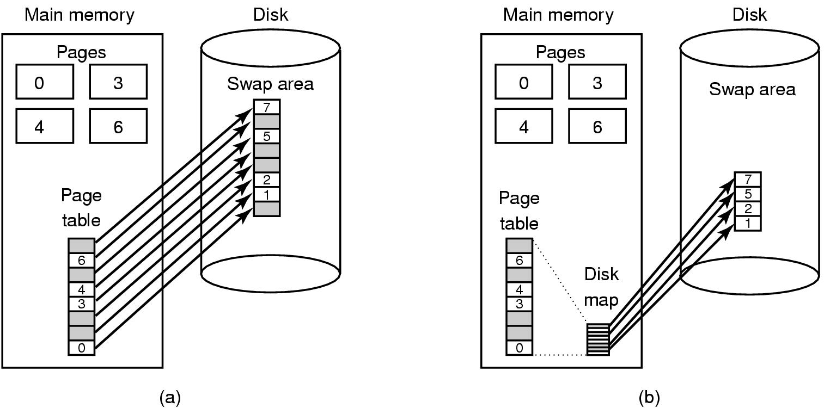
Backing Store-the picture
Paging to a static swap area (a) and
Paging to dynamic area (b)
Tanenbaum, Modern Operating Systems 3 e, (c) 2008 Prentice-Hall, Inc. All rights reserved. 0-13-6006639

Slide 100
Separation of Policy and Mechanism (1)
Memory management system
A low-level MMU handler (machine dependent)
A page fault handler that is part of the kernel (machine independent) Asks MMU to assign space for incoming page in the process
An external pager running in user space which contains the policy for page replacement and asks/receives pages from disk
Tanenbaum, Modern Operating Systems 3 e, (c) 2008 Prentice-Hall, Inc. All rights reserved. 0-13-6006639

Slide 101
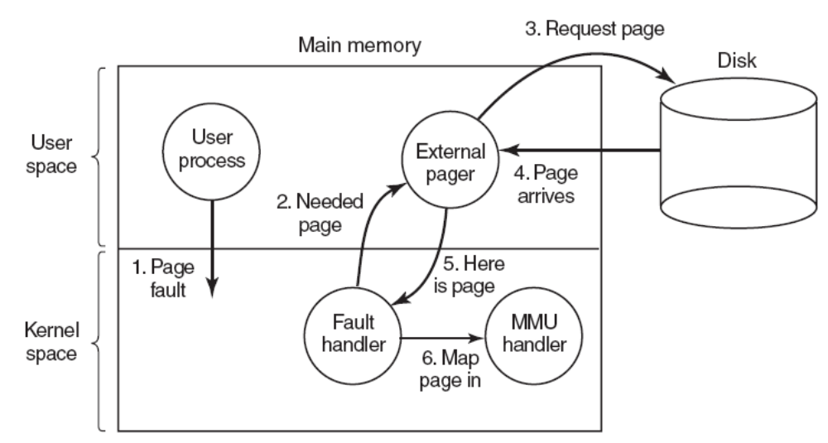
Separation of Policy and Mechanism (2)
How page fault happens-who does what.
Tanenbaum, Modern Operating Systems 3 e, (c) 2008 Prentice-Hall, Inc. All rights reserved. 0-13-6006639

Slide 102
The good vs the bad
The good: modular code => greater flexibility
The bad: Cross the user/kernel interface several times in the course of a page fault
Tanenbaum, Modern Operating Systems 3 e, (c) 2008 Prentice-Hall, Inc. All rights reserved. 0-13-6006639

Slide 103
Segmentation
A compiler has many tables that are built up as compilation proceeds, possibly including:
The source text being saved for the printed listing (on batch systems).
The symbol table – the names and attributes of variables.
The table containing integer, floating-point constants used.
The parse tree, the syntactic analysis of the program.
The stack used for procedure calls within the compiler.
Tanenbaum, Modern Operating Systems 3 e, (c) 2008 Prentice-Hall, Inc. All rights reserved. 0-13-6006639

Slide 104

One dimensional address space
. In a one-dimensional address space with growing tables, one table may bump into another.
Tanenbaum, Modern Operating Systems 3 e, (c) 2008 Prentice-Hall, Inc. All rights reserved. 0-13-6006639

Slide 105
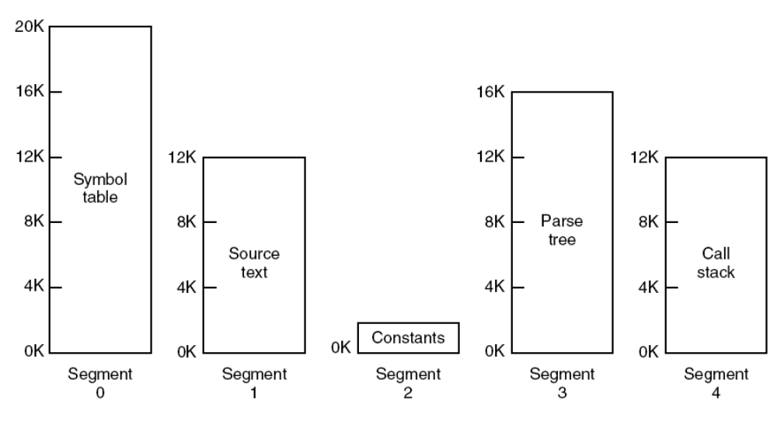
Segmentation
A segmented memory allows each table to grow or shrink independently of the other tables.
Tanenbaum, Modern Operating Systems 3 e, (c) 2008 Prentice-Hall, Inc. All rights reserved. 0-13-6006639

Slide 106
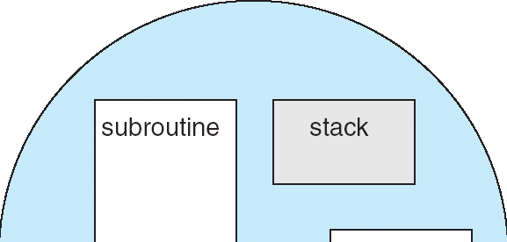
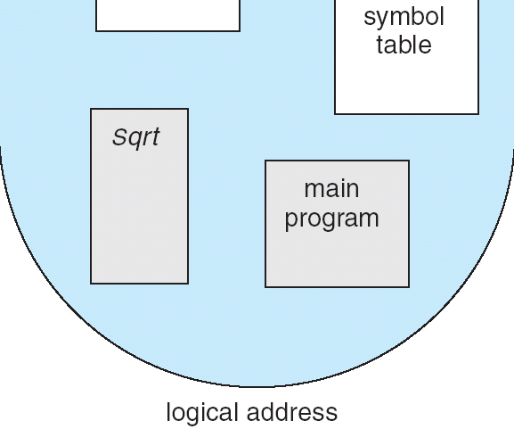
Segmentation
Memory-management scheme that supports user view of memory i.e. a collection of variable-sized segments, with no necessary ordering among segments
Basic Method
User's view of a program
Segments are numbered and are referred to by a segment number i.e. a logical address consists of a two tuple:
< segment-number, offset >
A program is a collection of segments, compiler constructs separate segments for :
  The code
  Global variables
  The heap, from which memory is allocated
  The stacks used, by each thread
  The standard C library

Slide 107
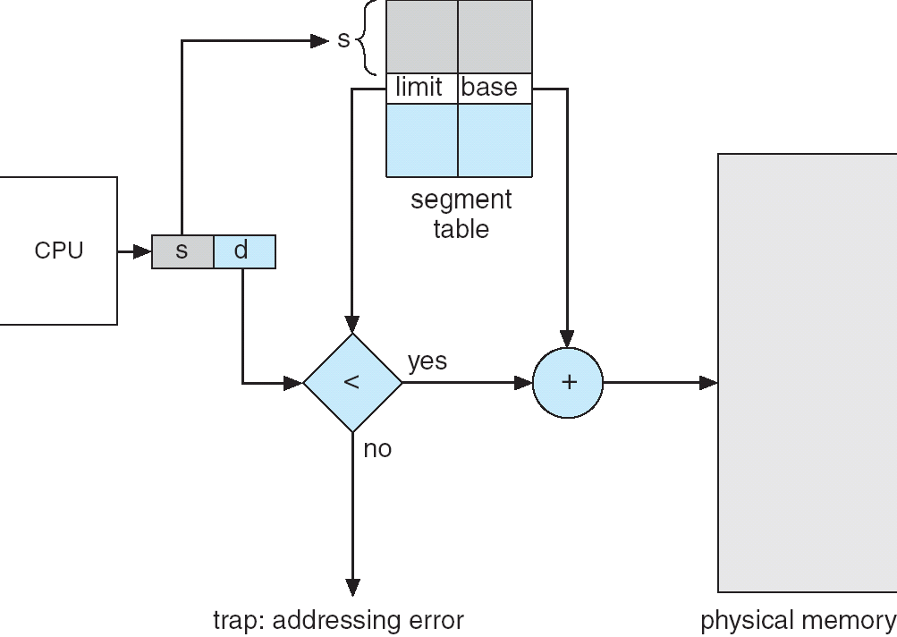
Segmentation
Hardware
Segment table – maps 2 dimensional physical addresses, each table entry has:
  base – contains the starting physical address where the segments reside in memory
  limit – specifies the length of the segment
Segment-table base register (STBR) points to the segment table’s location in memory
Segment-table length register (STLR) indicates number of segments used by a program;
Segment number s is legal if s < STLR
Segmentation hardware

Slide 108
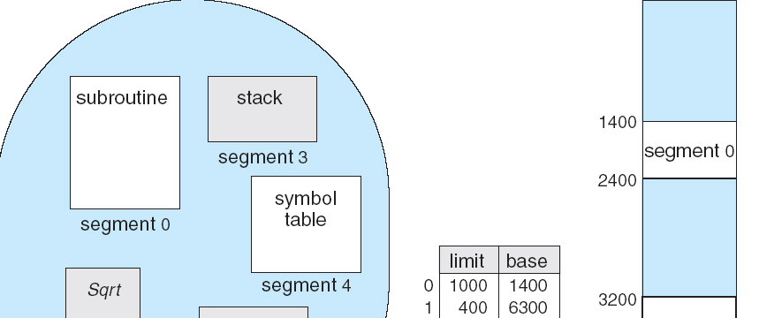
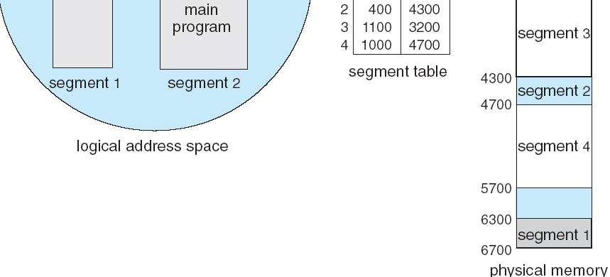
Segmentation
Segment 2 is 53 bytes long and begins at location 4300. Thus, a reference to byte 53 of segment 2 is mapped onto location 4300 + 53 = 4353
Segment 3, byte 852, is mapped to 3200 (the base of segment 3) + 852 = 4052
A reference to byte 1222 of segment 0 would result in a trap to the operating system, as this segment is only 1,000 bytes long
Example of Segmentation

Slide 109
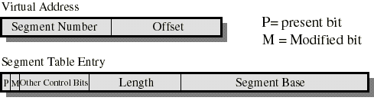
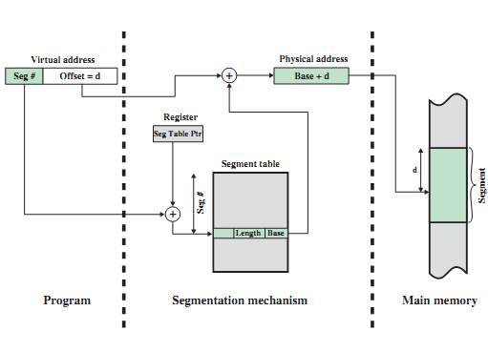
Segmentation

Slide 110
Advantages of Segmentation
Simplifies handling of data structures which are growing and shrinking
  Address space of segment n is of form (n,local address) where (n,0) is starting address
Can compile segments separately from other segments
Can put library in a segment and share it
Can have different protections (r,w,x) for different segments
Tanenbaum, Modern Operating Systems 3 e, (c) 2008 Prentice-Hall, Inc. All rights reserved. 0-13-6006639

Slide 111

Paging vs Segmentation
Comparison of paging and segmentation.
Tanenbaum, Modern Operating Systems 3 e, (c) 2008 Prentice-Hall, Inc. All rights reserved. 0-13-6006639

Slide 112
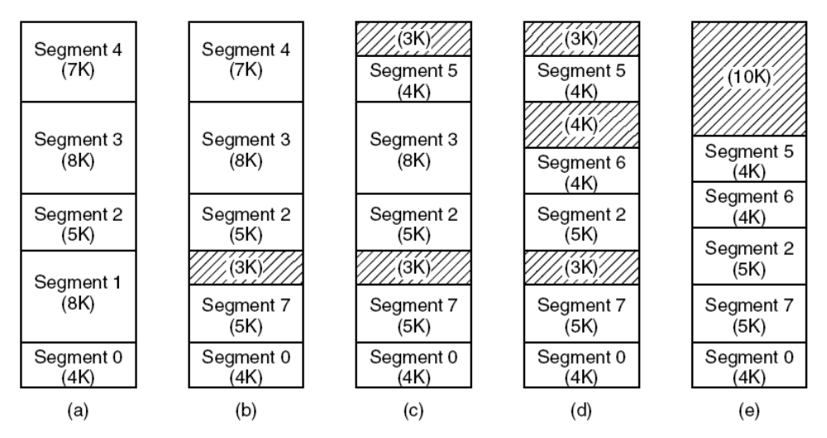
External fragging
(a)-(d) Development of checkerboarding. (e) Removal of the checkerboarding by compaction.
Tanenbaum, Modern Operating Systems 3 e, (c) 2008 Prentice-Hall, Inc. All rights reserved. 0-13-6006639

Slide 113
Segmentation with Paging
Examine two systems
  Multics (the first)
  The Pentium
Honeywell 6000
2*18 segments, up to 65,538 (36 bit) words per segment
Each program has a segment table (paged itself) containing segment descriptors
Segment descriptor points to page table
Tanenbaum, Modern Operating Systems 3 e, (c) 2008 Prentice-Hall, Inc. All rights reserved. 0-13-6006639

Slide 114
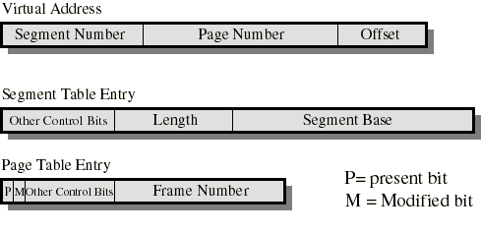
Segmentation with Paging
Tanenbaum, Modern Operating Systems 3 e, (c) 2008 Prentice-Hall, Inc. All rights reserved. 0-13-6006639

Slide 115
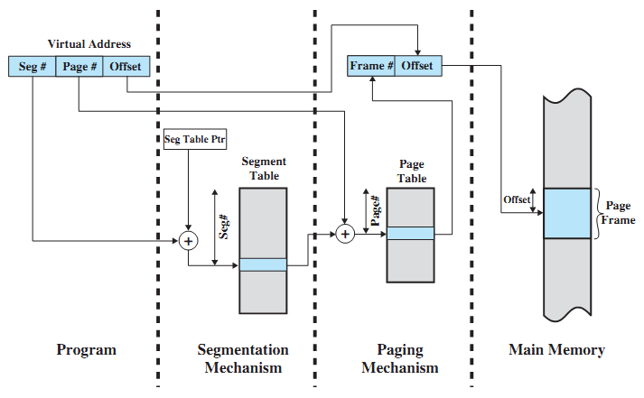
Segmentation with Paging
Tanenbaum, Modern Operating Systems 3 e, (c) 2008 Prentice-Hall, Inc. All rights reserved. 0-13-6006639

Slide 116
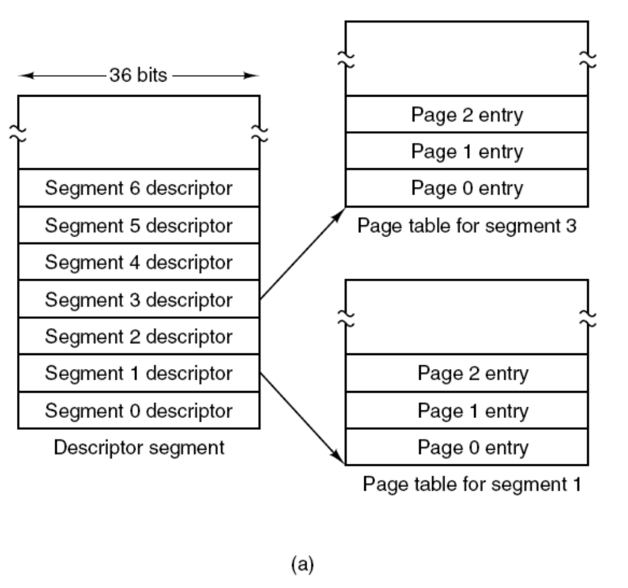
Segmentation with Paging: MULTICS
The MULTICS virtual memory. (a) The descriptor segment points to the page tables.
Tanenbaum, Modern Operating Systems 3 e, (c) 2008 Prentice-Hall, Inc. All rights reserved. 0-13-6006639

Slide 117
Segmentation with Paging
Segment descriptor says whether segment is in main memory or not
If any part of segment is in memory, entire segment is considered to be in memory
Virtual Address is (segment number, page number, offset within page)
Tanenbaum, Modern Operating Systems 3 e, (c) 2008 Prentice-Hall, Inc. All rights reserved. 0-13-6006639

Slide 118
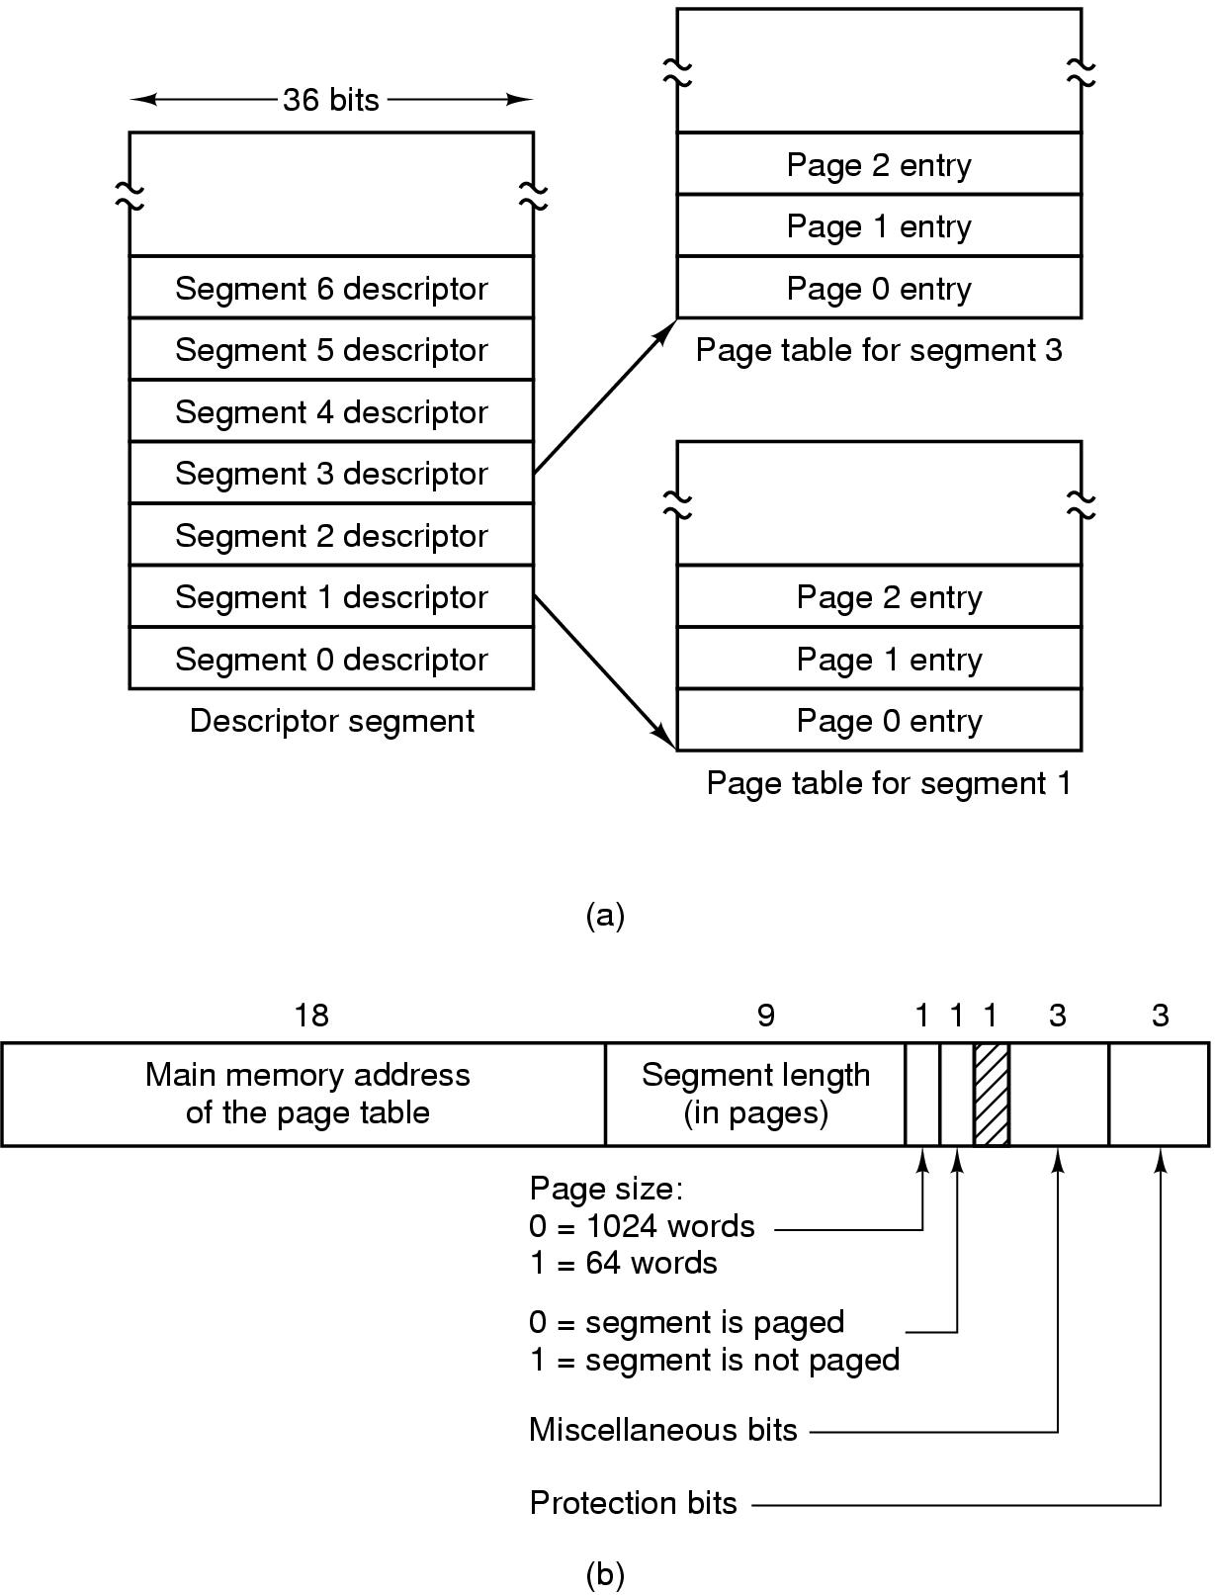
Segmentation with Paging: MULTICS
The MULTICS virtual memory. (b) A segment descriptor. The numbers are the field lengths.
Tanenbaum, Modern Operating Systems 3 e, (c) 2008 Prentice-Hall, Inc. All rights reserved. 0-13-6006639

Slide 119
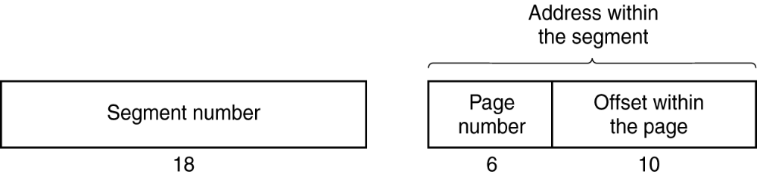
Segmentation with Paging: MULTICS
A 34-bit MULTICS virtual address.
Tanenbaum, Modern Operating Systems 3 e, (c) 2008 Prentice-Hall, Inc. All rights reserved. 0-13-6006639

Slide 120
Segmentation with Paging: MULTICS
When a memory reference occurs, the following algorithm is carried out:
The segment number used to find segment descriptor.
Check is made to see if the segment’s page table is in memory.
  If not, segment fault occurs.
  If there is a protection violation, a fault (trap) occurs.
Tanenbaum, Modern Operating Systems 3 e, (c) 2008 Prentice-Hall, Inc. All rights reserved. 0-13-6006639

Slide 121
Segmentation with Paging: MULTICS
Page table entry for the requested virtual page examined.
  If the page itself is not in memory, a page fault is triggered.
  If it is in memory, the main memory address of the start of the page is extracted from the page table entry
The offset is added to the page origin to give the main memory address where the word is located.
The read or store finally takes place.
Tanenbaum, Modern Operating Systems 3 e, (c) 2008 Prentice-Hall, Inc. All rights reserved. 0-13-6006639

Slide 122
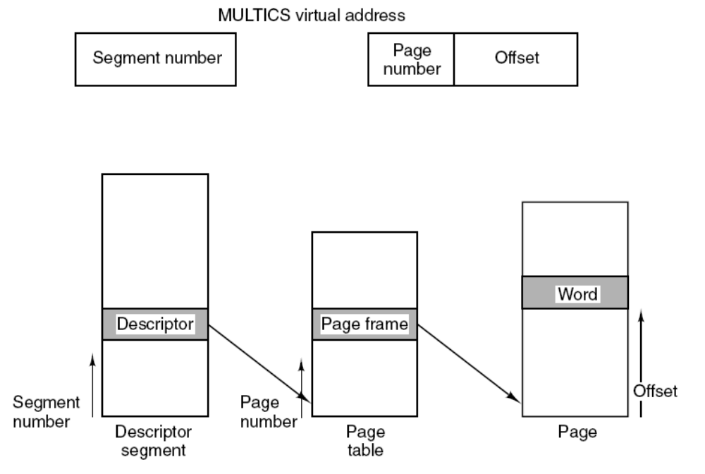
Segmentation with Paging: MULTICS
Conversion of a two-part MULTICS address into a main memory address.
Tanenbaum, Modern Operating Systems 3 e, (c) 2008 Prentice-Hall, Inc. All rights reserved. 0-13-6006639

Slide 123
MULTICS TLB
Too many references with algorithm
Use TLB (16 words)
Keep addresses of the 16 most recently referenced pages in TLB
Addressing hardware checks to see if address is in TLB
If so, gets address directly from TLB
If not, invoke algorithm (check descriptor…)
Tanenbaum, Modern Operating Systems 3 e, (c) 2008 Prentice-Hall, Inc. All rights reserved. 0-13-6006639

Slide 124
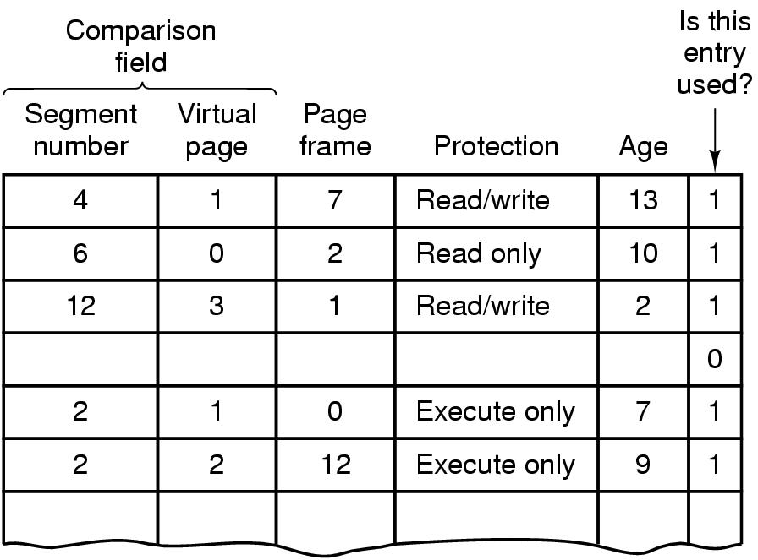
Segmentation with Paging: MULTICS (10)
Tanenbaum, Modern Operating Systems 3 e, (c) 2008 Prentice-Hall, Inc. All rights reserved. 0-13-6006639

Slide 125
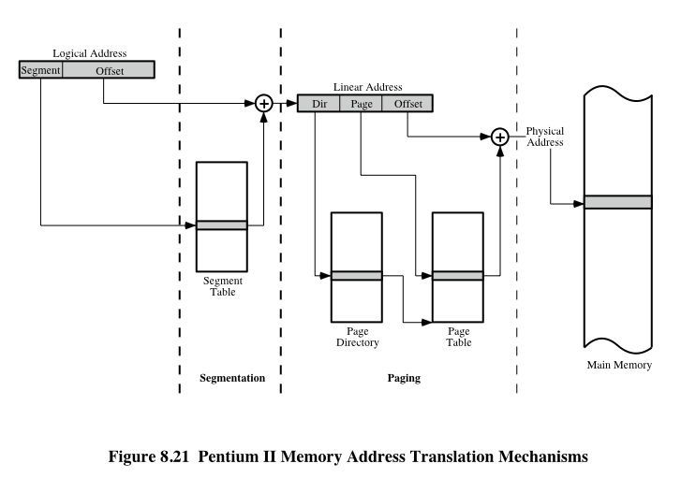
Segmentation with Paging: The Pentium
Tanenbaum, Modern Operating Systems 3 e, (c) 2008 Prentice-Hall, Inc. All rights reserved. 0-13-6006639

Slide 126
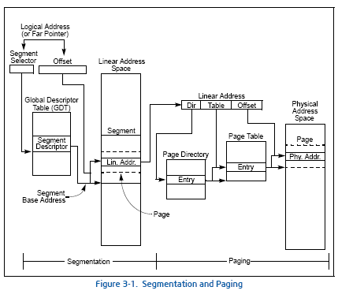
Segmentation with Paging: The Pentium

Slide 127
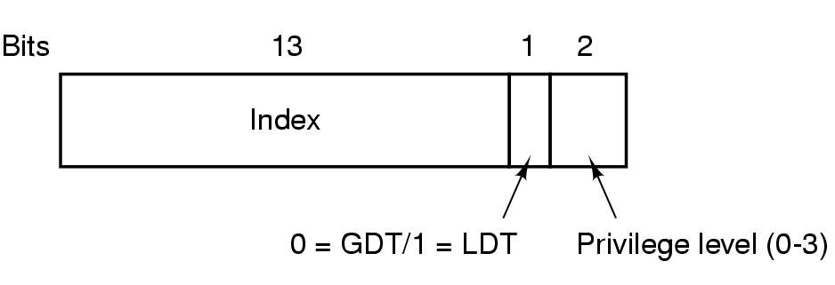
Segmentation with Paging: The Pentium (1)
. A Pentium selector.
Tanenbaum, Modern Operating Systems 3 e, (c) 2008 Prentice-Hall, Inc. All rights reserved. 0-13-6006639

Slide 128
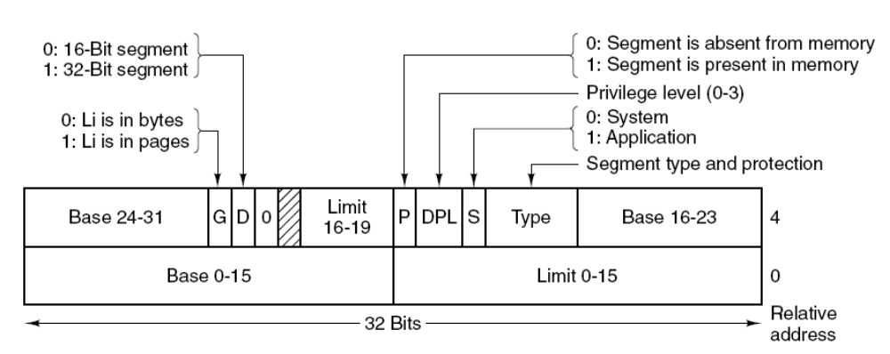
Segmentation with Paging: The Pentium (2)
Pentium code segment descriptor.
Data segments differ slightly.
Tanenbaum, Modern Operating Systems 3 e, (c) 2008 Prentice-Hall, Inc. All rights reserved. 0-13-6006639

Slide 129
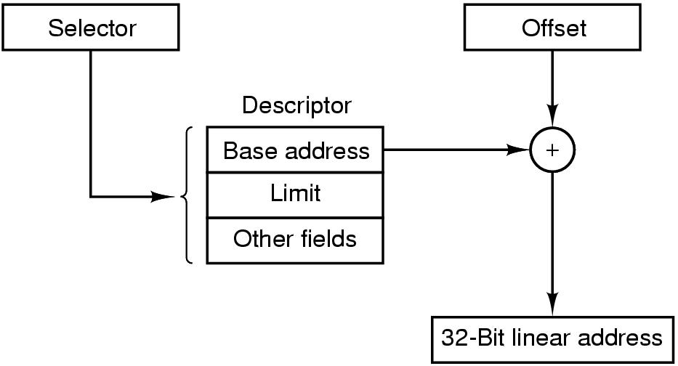
Segmentation with Paging: The Pentium (3)
Conversion of a (selector, offset)
pair to a linear address.
Tanenbaum, Modern Operating Systems 3 e, (c) 2008 Prentice-Hall, Inc. All rights reserved. 0-13-6006639

Slide 130
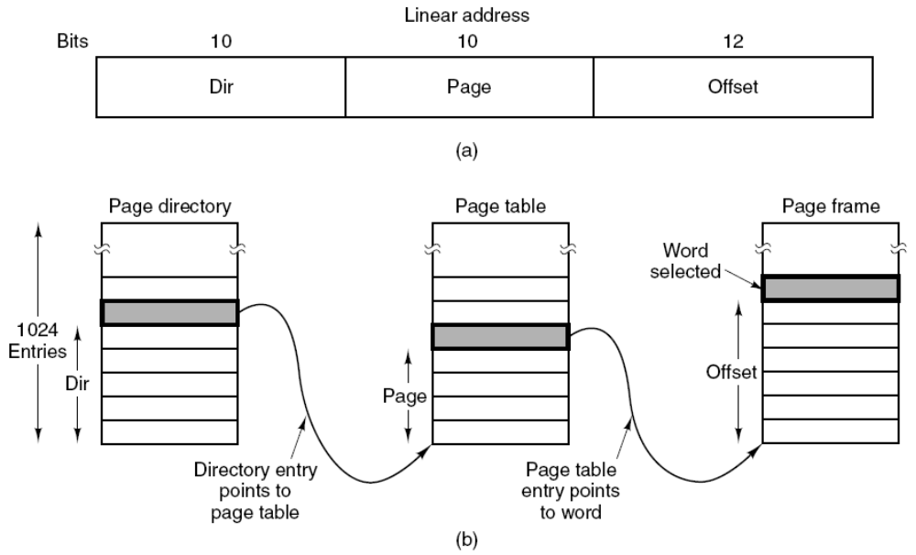
Segmentation with Paging: The Pentium (4)
Mapping of a linear address onto a physical address.
Tanenbaum, Modern Operating Systems 3 e, (c) 2008 Prentice-Hall, Inc. All rights reserved. 0-13-6006639

Slide 131
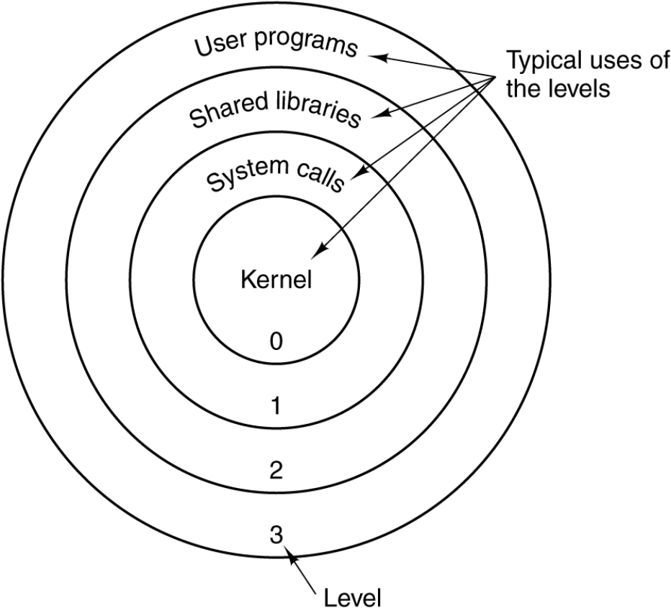
Segmentation with Paging: The Pentium (5)
. Protection on the Pentium.
Tanenbaum, Modern Operating Systems 3 e, (c) 2008 Prentice-Hall, Inc. All rights reserved. 0-13-6006639

